Slide 1
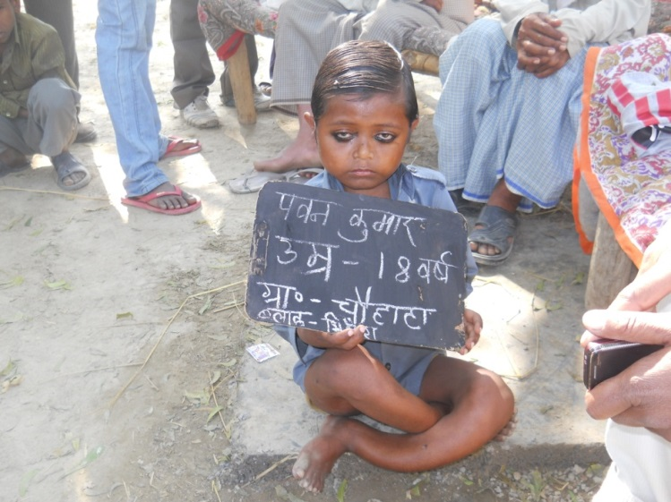
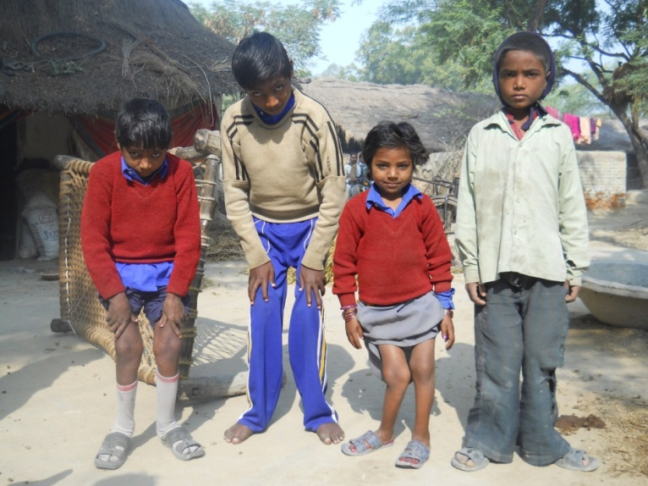
Significant Need
India ranked a low 122th in a survey of 123 nations on safe water
2000 children die in India every day due to waterborne disease
Stunted development of 20 million children annually
Two-thirds of hospital beds filled with patients with waterborne disease
Fluorosis affected Children in Fatehpur, U.P.

Slide 2
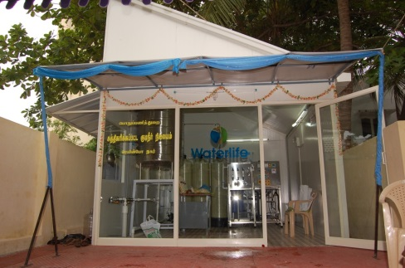
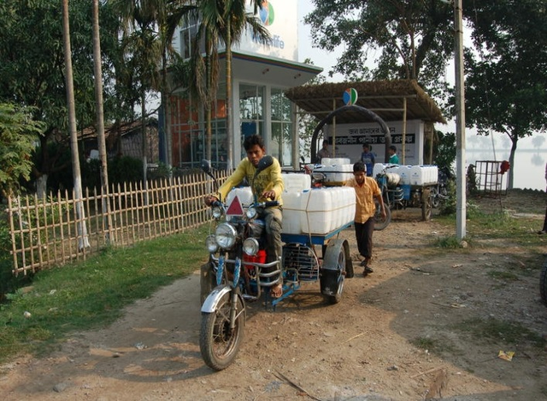
The Waterlife Model
Innovative business models
Decentralized “total” systems and services offering
Focus on health, hygiene and quality
Long term sustainability
Long Term Operation and Maintenance by Waterlife
User charges to create revenue stream for O&M – Rs. 4 to 7 for 20 litres
Education and Awareness to change behaviour
Superior Technology- Green and Environmentally friendly
Environmentally, Socially and Economically Sustainable

Slide 3

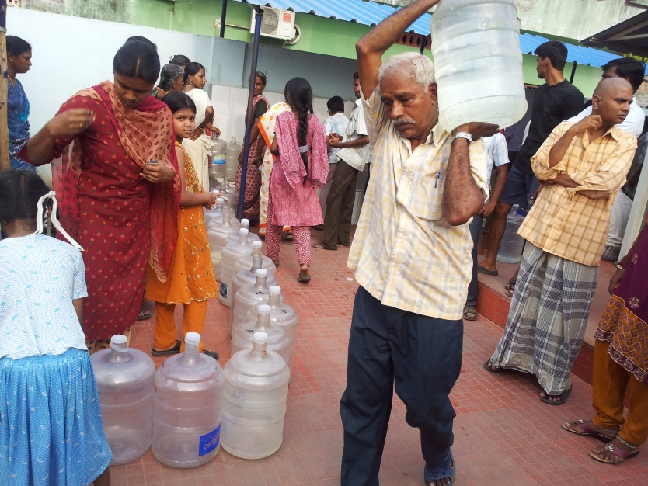
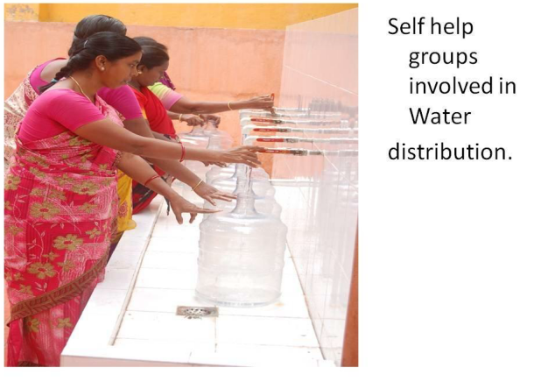
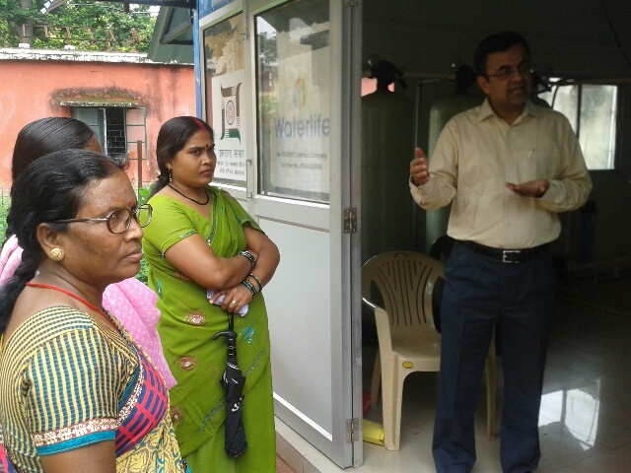
A typical Community Water System in a village
People collecting water after paying user fees
Lady SHG group filling water from CWS
Lady Operator in villages in Jharkhand

Slide 4
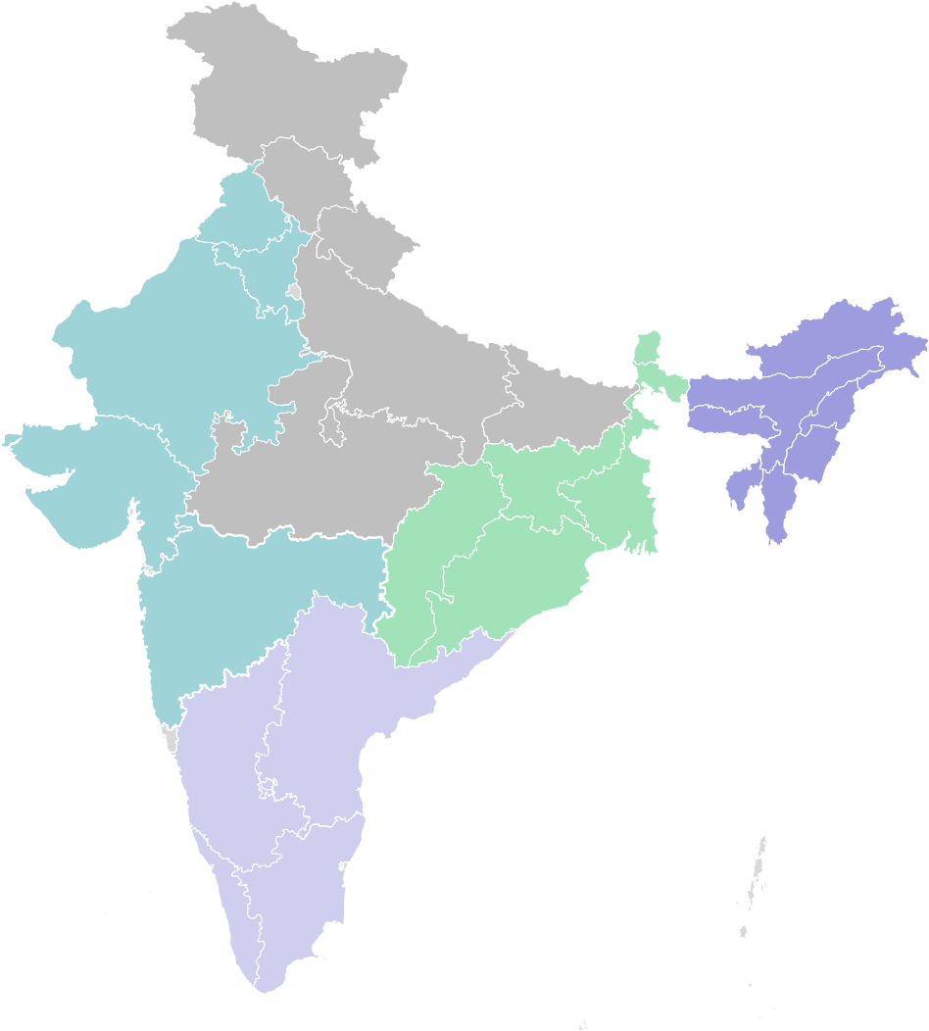
WATERLIFE PRESENCE & EXECUTION- INDIA
Waterlife’s Installed Base
Social Impact
Presence in 4000 villages
Provide Safe Water to about 10 Million People
Plan to Replicate in Africa and S. Asia Countries
Rajasthan
Op: 4
TBC: 71
WIP:15
UP
CRU: 2693
Bihar
O&M: 145
MP
TBC: 2
CRU: 83
Jharkhand
Op: 3
TBC: 4
WIP: 1
W Bengal
Op: 1
CRU: 46
Maharashtra
Op: 8
CRU: 142
Karnataka
Op: 117
TBC: 79
WIP:85
CRU: 6
AP
Op: 2
TBC:1
Kerala
Installed: 16
O & M: 16
Pondicherry
Op: 21
WIP:26
Pg <number>

Slide 5
Learning Points
Scale Up Enablers:
Huge Scale up and significant outcomes can come only with PPP partnership – its most times an asset based business
  Eg.: CWS, Swachh Bharat etc
Governance and Transparency
High adherence to Quality – Lower cost and tender based mechanisms are a barrier
Challenges:
Working Capital Challenges – WC cycle is large, Payment Delays
Any such initiative needs very large Working Capital initially
Transparency and Governance
Availability of Funds – Banks, Fund Sources, Priority Funding
Government often seen as a destroyer of Value by VCs

